Slide 1
Project Webdevelopment

Slide 2
Evaluation Criteria
25% Desirability & Viability
25% Feasibility & Prototye Completion
25% Innovation & Creativity
25%Impact & Sustainability

Slide 3
25% Desirability & Viability
How desired is your offered solutions by the user and how can organizations justify investions into it? - When evaluating your ideas, we will consider questions like:
Did the group develop the solution based on the user’s demands?
Is the problem that is aimed to be solved understandable and addressed?
Can the solution be scaled to all the people the group intended to reach with it?
Does it exceed customer's expecations?
25% Feasibility & Prototye Completion
In your solution you don't have to implemente all features you maybe thought of initially, but the features you implement should be executable and work properly (MVP approach). Show us that you understood and applied the learned materials. - When evaluating your ideas, we will consider questions like:
Is the solution testable, executable, and can the group show a minimum viable product (MVP)?
Does the solution follow the offered materials on edyoucated?
Are there major errors the project group did not consider that lower feasibility?
The solution does not have to be perfect or contain all features, but does the idea come to life with the chosen demonstration format?

Slide 4
25% Innovation & Creativity
Is your way of thinking pathbreaking instead of just going with the flow? - When evaluating your ideas, we will consider questions like:
Did the group come up with an innovative solution to the initial problem or challenge?
Does this offer something that hasn’t been done already? If it has been done, does this offer something different?
How creative has the group been in solving the challenge?
Did they come up with a radical approach, or did they follow existing patterns and solutions?
25%Impact & Sustainability
Does the project make the world a more sustainable place in the long run and did you use tech for good? When evaluating your ideas, we will consider questions like:
What would be the positive impact on society if the idea is implemented?
Does it improve a dysfunctional system?
How environmentally sustainable is the solution?
How socially sustainable is the solution?

Slide 5
Must haves
Check out our step-by-step submission instructions.
We expect from you and your project team:
Find a project idea on your own following the overall project subject
Search for data sets which you can use
Make sure that you do not copy an idea which exists already (we will notice that and won't be able to give you any points in the "Innovation & Creativity" section)
Keep it simple, focus on developing a MVP/Prototype. Your solution dont have to contain all features you initially came up with, but the ones you're implementing should work properly
You have to submit the following:
A link to your main solution (github repository, figma link, etc..)
A short video explaining the main features of your solution (max. 5 minutes). Make sure that your video is accessible for us (use loom or upload it on YouTube)
You have to hand in your project solution before the deadline expires
Everyone of the project group has to fill out our submission typeform!
Make sure that your solution is accessible by us

Slide 6
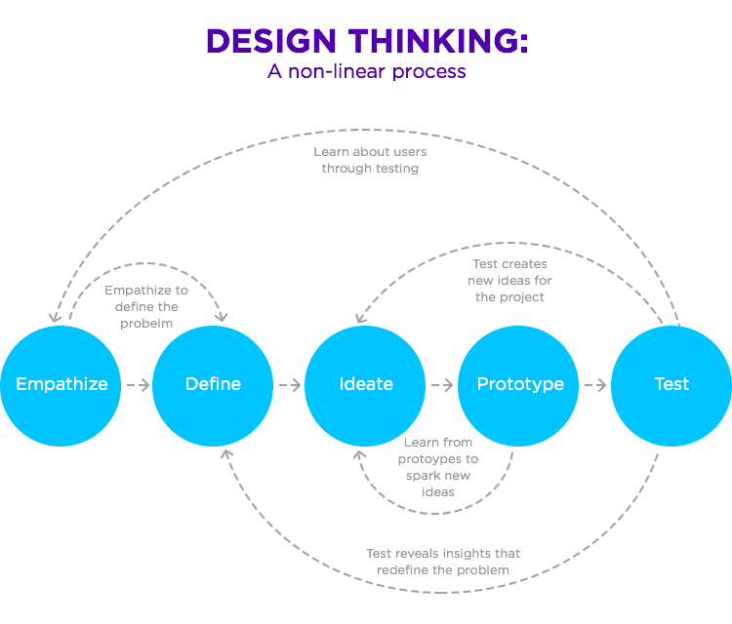

Slide 7
Empathize/Define → The Issue
Issue:
ressources and energy are running out
→ we have to live sustainably
→ reduction pesticides
→ reduction of transportation
→…
→ Permacualtur

Slide 8
Permacultur
use deges and valve marginal
observe and interact
catch and store energy
obtain a yield
apply selfregulation & accept feedback
obtain a yield
use & valve rennewable resources and service
product no waste
design from pattents to details
integrate rather than segregate
use small and slow solutions
Uue & valve deversity

Slide 9
Ideate
Suppoort a Permaculturteam (Evergreen Farm - Permakultur Essen) with a webside

Slide 10
Prototype

